Slide 1
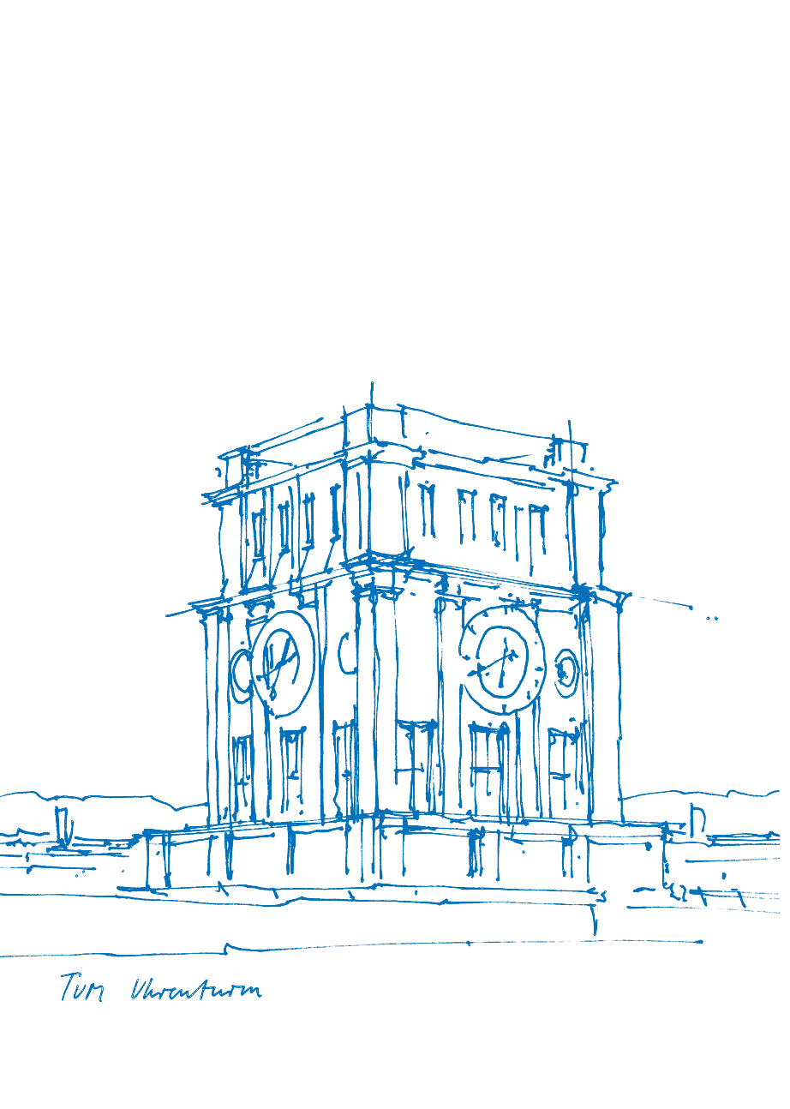
Reinforcement Learning for Adaptive Locomotion
of a snake-like Robot using Tensorflow
Jonathan Rösner
Technische Universität München
Department of Informatics
Robotics and Embedded Systems
Garching, 24. November 2017

Slide 2
Outline
1. | What is Reinforcement Learning?
2. | Exploration vs Exploitation
3. | Different Ways to explore
4. | Implementation
5. | Results
6. | Conclusion & Future Work
Jonathan Rösner (TUM) | Bachelor’s Thesis Defense

Slide 3
What is Reinforcement Learning?
Agents and environments
Jonathan Rösner (TUM) | Bachelor’s Thesis Defense

Slide 4
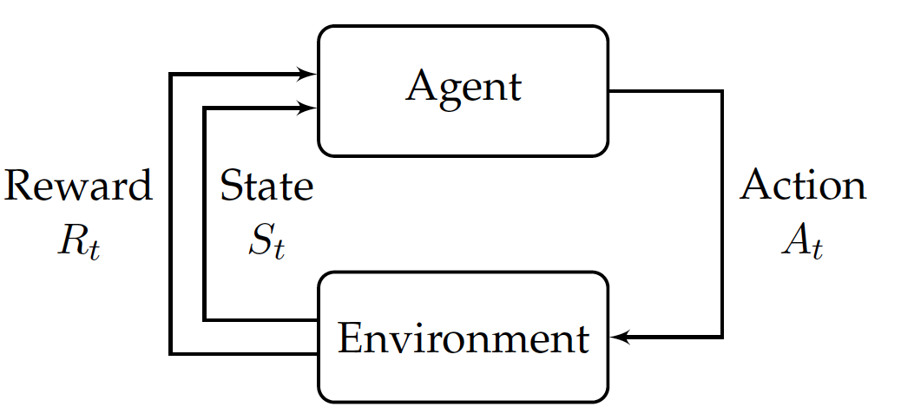
What is Reinforcement Learning?
Agents and environments
Three Components:
Environment
Agent
Time
Jonathan Rösner (TUM) | Bachelor’s Thesis Defense

Slide 5
What is Reinforcement Learning?
Agents and environments
Three Components:
Environment
Agent
Time
Agent can observe environment
Jonathan Rösner (TUM) | Bachelor’s Thesis Defense

Slide 6
What is Reinforcement Learning?
Agents and environments
Three Components:
Environment
Agent
Time
Agent can observe environment
Agent can act upon environment
Jonathan Rösner (TUM) | Bachelor’s Thesis Defense

Slide 7
What is Reinforcement Learning?
Agents and environments
Three Components:
Environment
Agent
Time
Agent can observe environment
Agent can act upon environment
Environment emits reward
Jonathan Rösner (TUM) | Bachelor’s Thesis Defense

Slide 8
What is Reinforcement Learning?
Agents and environments
Agent can then create a policy that maps from states to actions
In the beginning it is random but by learning it approximates the optimal policy
Jonathan Rösner (TUM) | Bachelor’s Thesis Defense

Slide 9
What is Reinforcement Learning?
How does it learn?
Jonathan Rösner (TUM) | Bachelor’s Thesis Defense

Slide 10
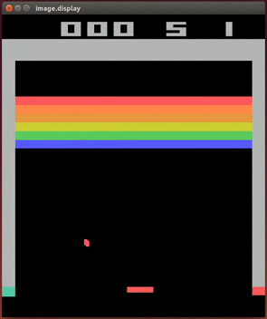
What is Reinforcement Learning?
How does it learn?
Sample transitions from the environment
Jonathan Rösner (TUM) | Bachelor’s Thesis Defense

Slide 11
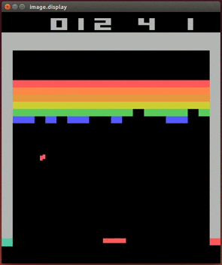
What is Reinforcement Learning?
How does it learn?
Sample transitions from the environment
Pick actions that return high reward
Jonathan Rösner (TUM) | Bachelor’s Thesis Defense

Slide 12
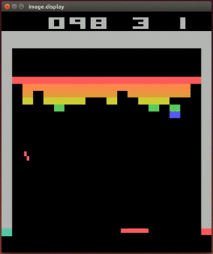
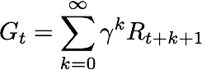
What is Reinforcement Learning?
How does it learn?
Sample transitions from the environment
Pick actions that return high reward
Goal is to always maximise sum of rewards
Jonathan Rösner (TUM) | Bachelor’s Thesis Defense

Slide 13
Exploration vs Exploitation
What is the difference?
Jonathan Rösner (TUM) | Bachelor’s Thesis Defense

Slide 14
Exploration vs Exploitation
What is the difference?
Exploitation:
taking the action that is thought to yield the highest reward
Jonathan Rösner (TUM) | Bachelor’s Thesis Defense

Slide 15
Exploration vs Exploitation
What is the difference?
Exploitation:
taking the action that is thought to yield the highest reward
Exploration:
taking a new (often random) action
Jonathan Rösner (TUM) | Bachelor’s Thesis Defense

Slide 16
Exploration vs Exploitation
Why not always exploit?
Jonathan Rösner (TUM) | Bachelor’s Thesis Defense

Slide 17
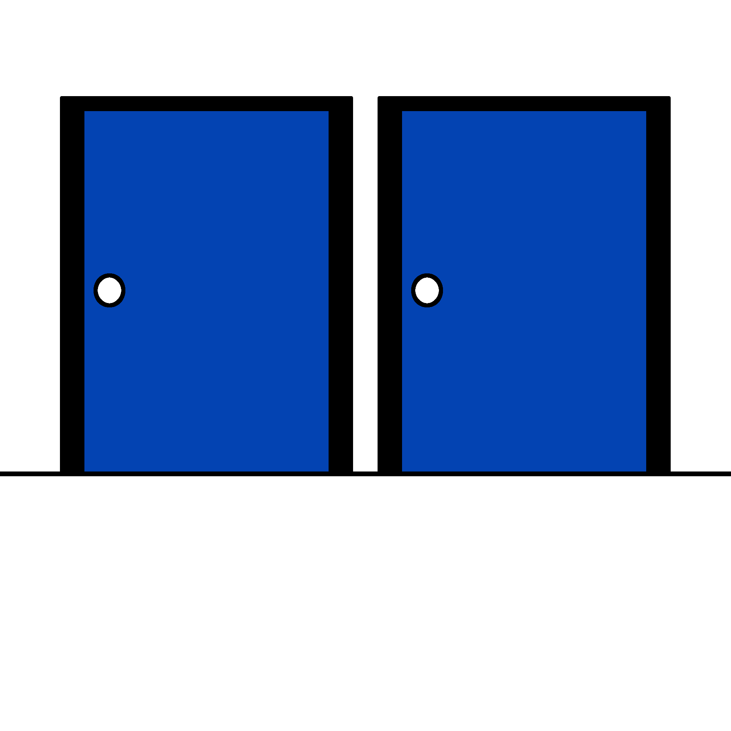
Exploration vs Exploitation
Why not always exploit?
An agent has the choice to open the left or the right door
Jonathan Rösner (TUM) | Bachelor’s Thesis Defense

Slide 18
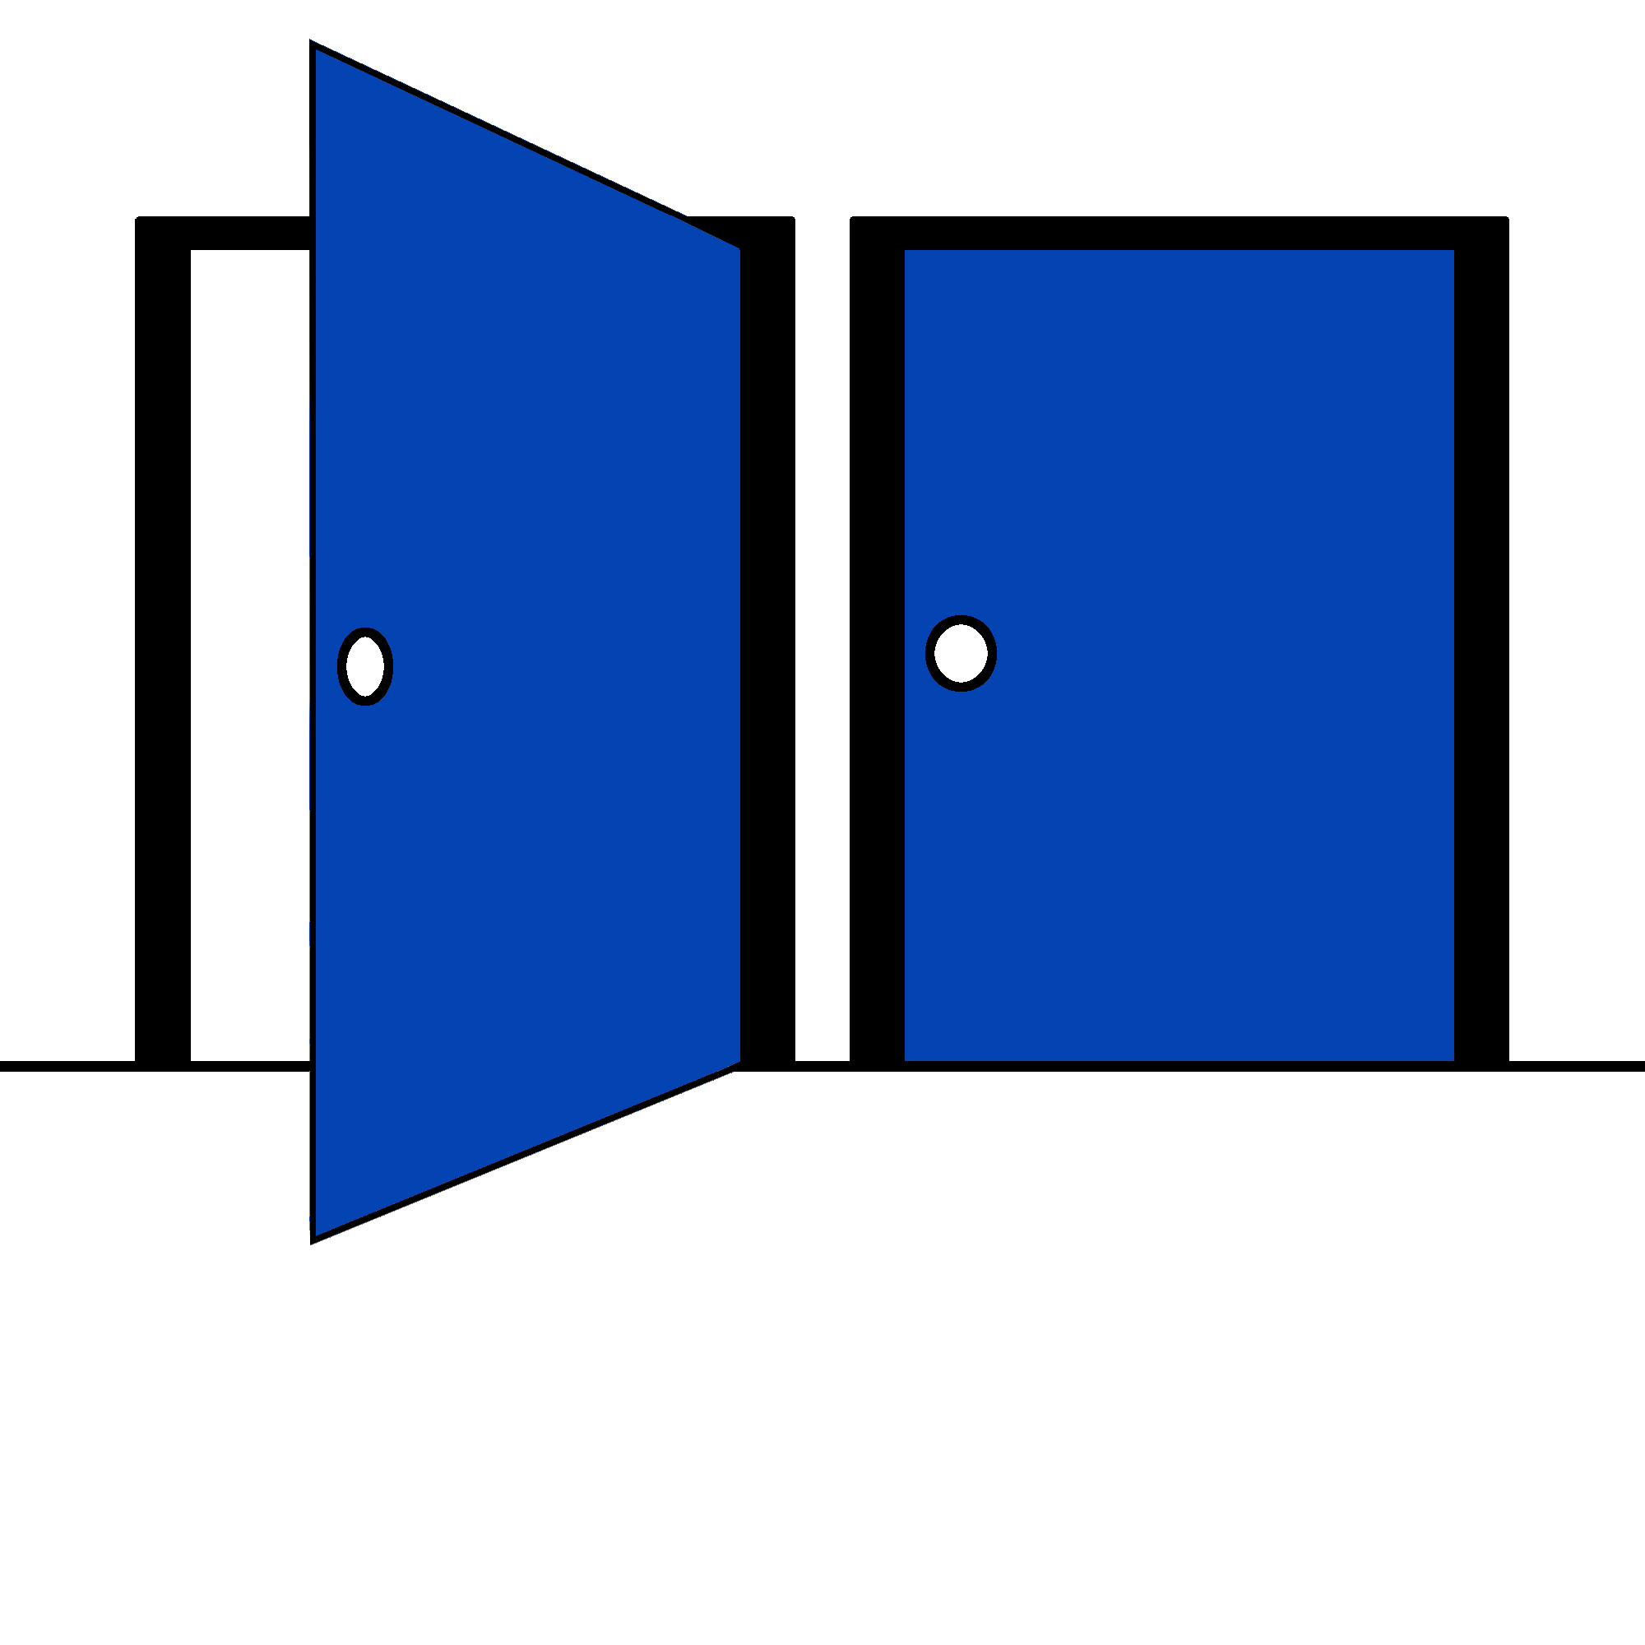
Exploration vs Exploitation
Why not always exploit?
An agent has the choice to open the left or the right door
When opening the left door he receives -5 reward
Jonathan Rösner (TUM) | Bachelor’s Thesis Defense

Slide 19
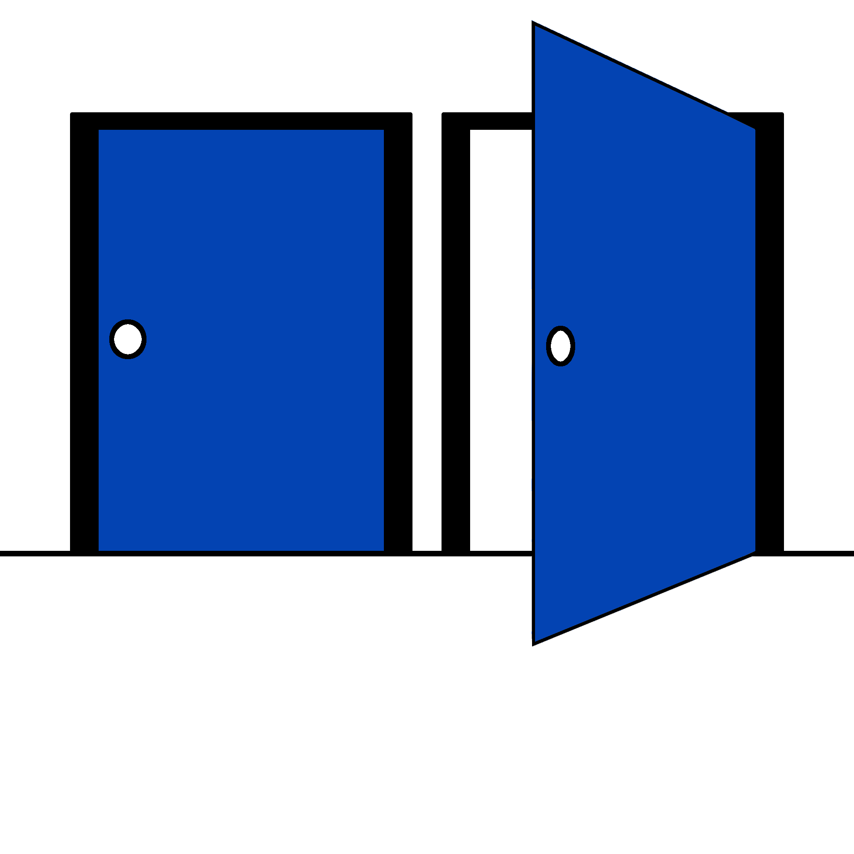
Exploration vs Exploitation
Why not always exploit?
An agent has the choice to open the left or the right door
When opening the left door he receives -5 reward
When opening the right door he receives +5 reward
Jonathan Rösner (TUM) | Bachelor’s Thesis Defense

Slide 20
Exploration vs Exploitation
Why not always exploit?
An agent has the choice to open the left or the right door
When opening the left door he receives -5 reward
When opening the right door he receives +5 reward
Should the agent always open the right door?
Jonathan Rösner (TUM) | Bachelor’s Thesis Defense

Slide 21
Exploration vs Exploitation
Why not always exploit?
Answer: No!
Jonathan Rösner (TUM) | Bachelor’s Thesis Defense

Slide 22
Exploration vs Exploitation
Why not always exploit?
Answer: No!
Maybe next time he opens the left he receives +10 reward
Jonathan Rösner (TUM) | Bachelor’s Thesis Defense

Slide 23
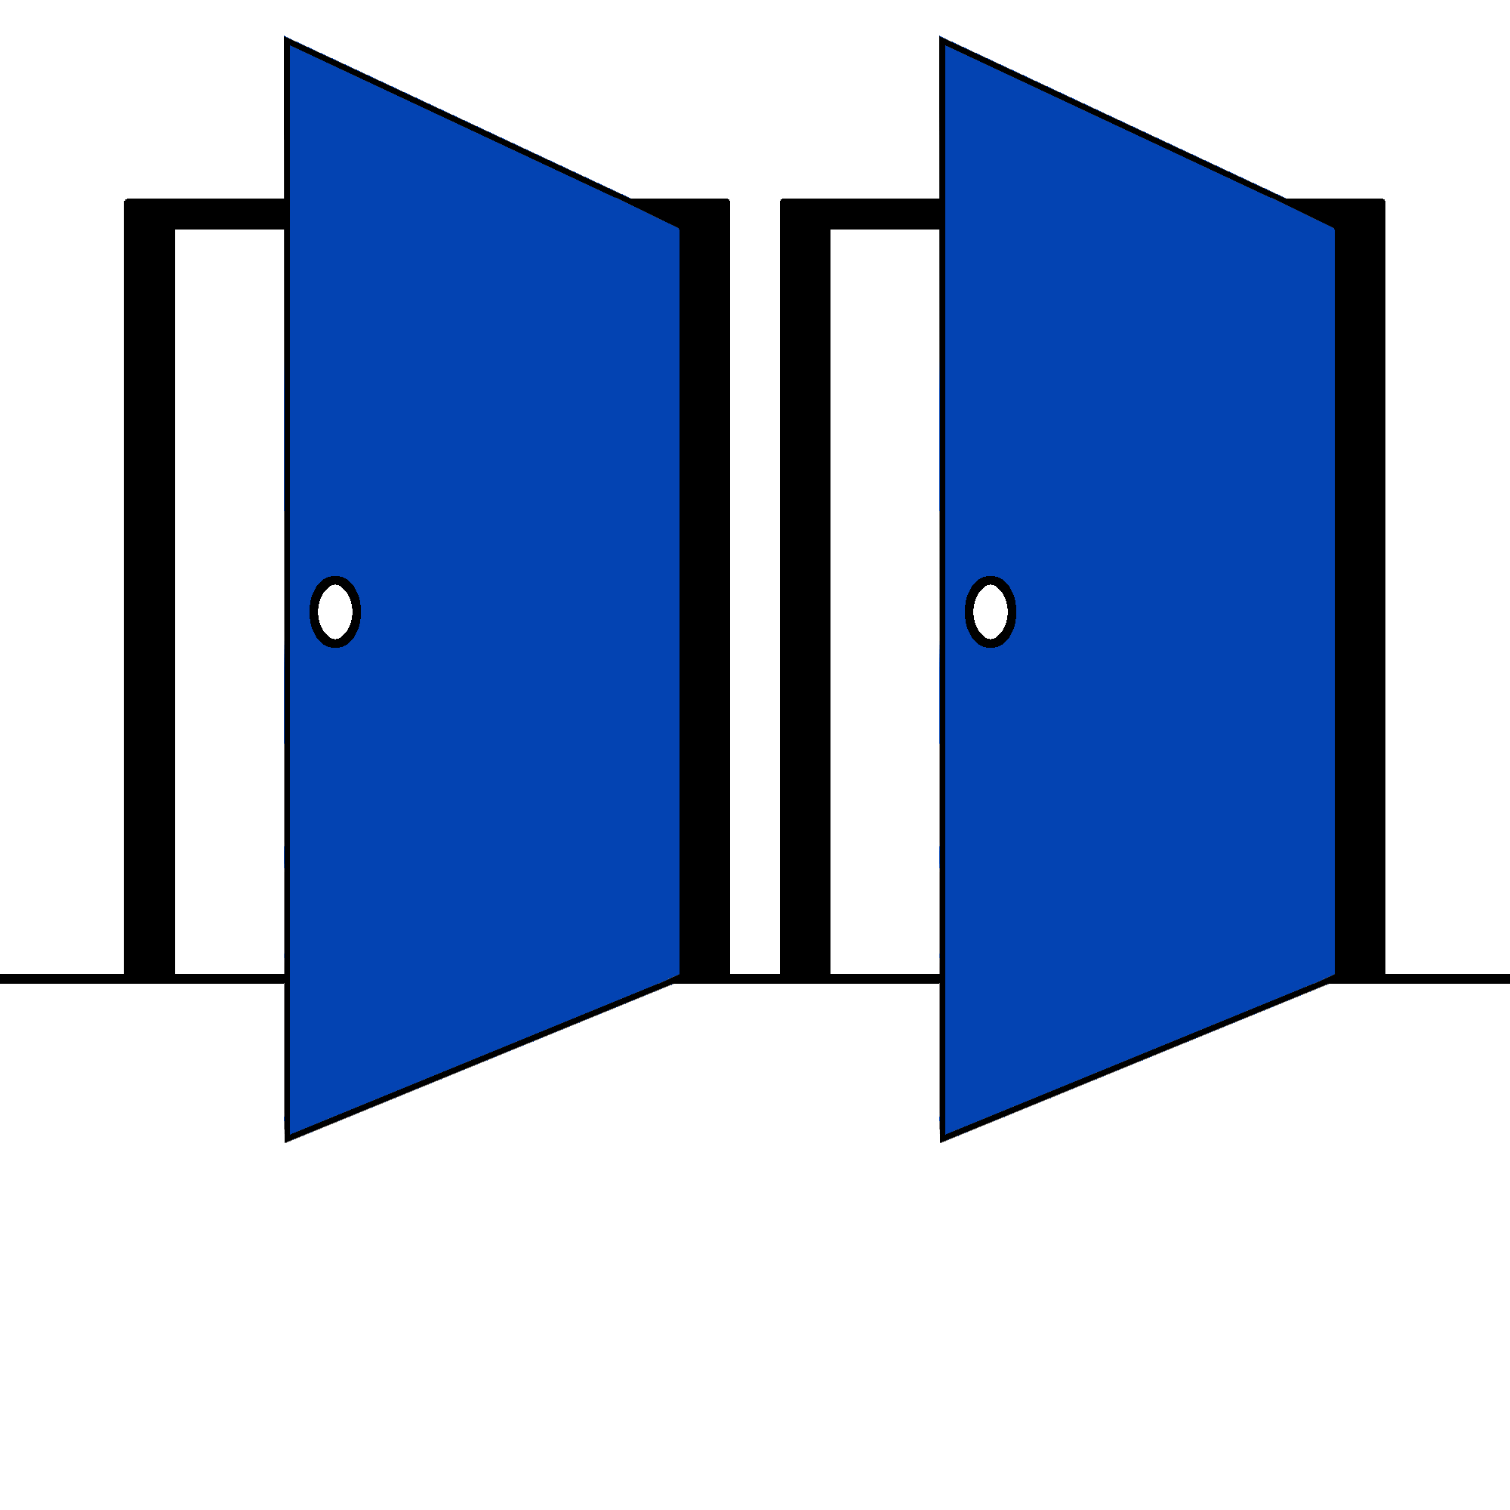
Exploration vs Exploitation
Why not always exploit?
Answer: No!
Maybe next time he opens the left he receives +10 reward
Solution is to sometimes explore and sometimes exploit
Jonathan Rösner (TUM) | Bachelor’s Thesis Defense

Slide 24
Different ways to explore
Many different ways to achieve the same goal
Jonathan Rösner (TUM) | Bachelor’s Thesis Defense

Slide 25
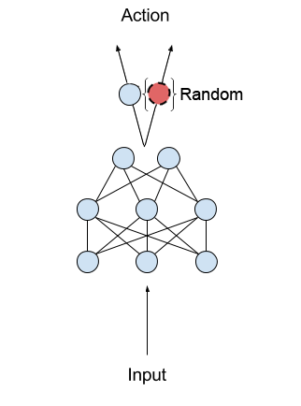
Different ways to explore
ε-Greedy Policy
With probability of ε choose a random action, otherwise select the best action
Decay ε after a while to exploit more
Jonathan Rösner (TUM) | Bachelor’s Thesis Defense

Slide 26
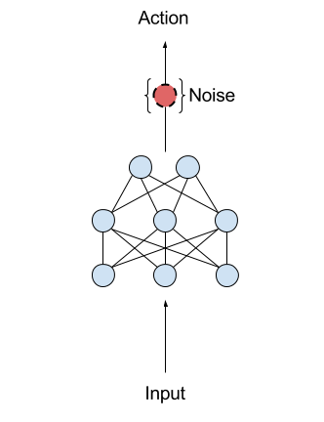
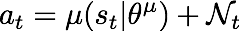
Different ways to explore
Action noise
In every timestep add a noise factor to the action
Noise terms can be correlated
Jonathan Rösner (TUM) | Bachelor’s Thesis Defense

Slide 27
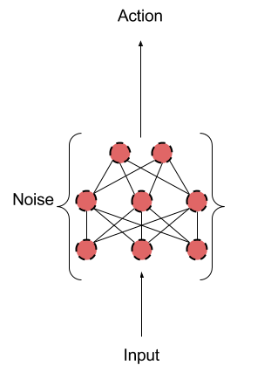
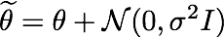
Different ways to explore
Parameter Noise
Instead of adding noise to the action add it directly to the network’s parameters
Computationally Expensive, therefore compute noise only once per episode
Jonathan Rösner (TUM) | Bachelor’s Thesis Defense

Slide 28
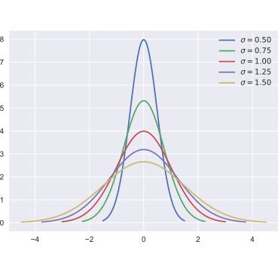
Different ways to explore
Standard deviation noise
Change the distribution of the policy to increase or decrease exploration
Higher standard deviation means more exploration
Jonathan Rösner (TUM) | Bachelor’s Thesis Defense

Slide 29

Implementation
Three very different algorithms:
Deep-Q-Network
Deep Deterministic Policy Gradient
Proximal Policy Optimization
Tensorflow for deep neural networks
OpenAI for simulations (especially MuJoCo)
Jonathan Rösner (TUM) | Bachelor’s Thesis Defense

Slide 30
Results
How did the algorithms perform?
Jonathan Rösner (TUM) | Bachelor’s Thesis Defense

Slide 31
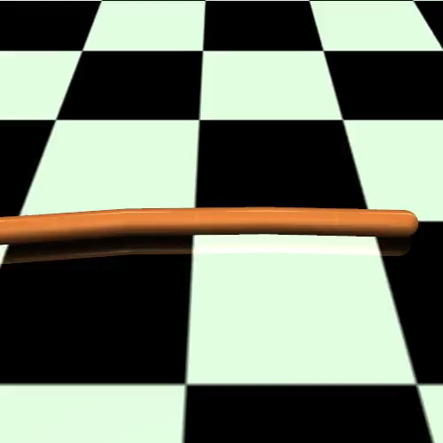
Results
Deep Deterministic Policy Gradient with action noise
Did not learn what we would consider snake-like movement
Got stuck in a local maximum
Jonathan Rösner (TUM) | Bachelor’s Thesis Defense

Slide 32
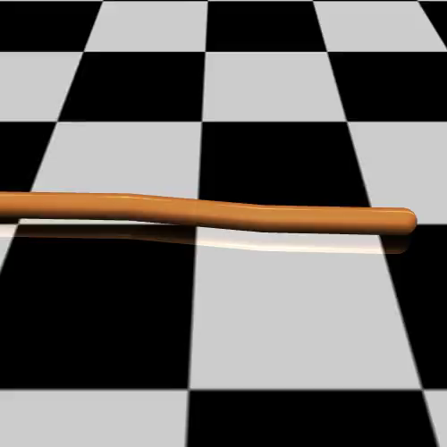
Results
Deep Deterministic Policy Gradient with parameter noise
Could not reproduce the results from the original paper
Did not learn a useful policy at all
Jonathan Rösner (TUM) | Bachelor’s Thesis Defense

Slide 33
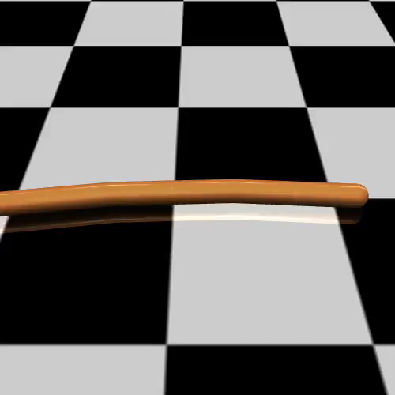
Results
Proximal Policy Optimization
Good results
Least computationally expensive
But high variance between different runs
Jonathan Rösner (TUM) | Bachelor’s Thesis Defense

Slide 34
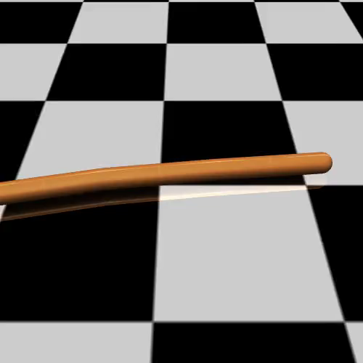
Results
Proximal Policy Optimization with new method for exploration
Even better results
Still high variance
Jonathan Rösner (TUM) | Bachelor’s Thesis Defense

Slide 35
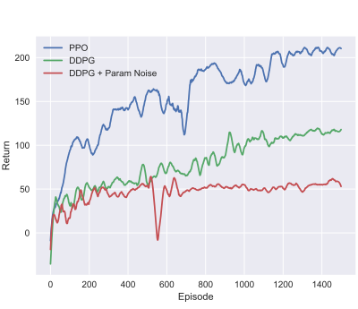
Results
Comparing the different algorithms and noise factors
PPO outperforms DDPG every run
Jonathan Rösner (TUM) | Bachelor’s Thesis Defense

Slide 36
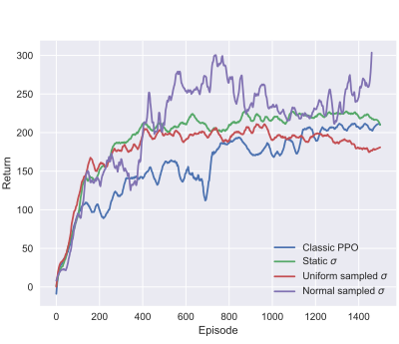
Results
Comparing the different algorithms and noise factors
Sampling the standard deviation from a normal distribution often made significant difference to the early learning curve
Jonathan Rösner (TUM) | Bachelor’s Thesis Defense

Slide 37
Conclusion & Future Work
RL can learn difficult tasks even in high dimensional space
Jonathan Rösner (TUM) | Bachelor’s Thesis Defense

Slide 38
Conclusion & Future Work
RL can learn difficult tasks even in high dimensional space
Algorithms still have flaws:
Jonathan Rösner (TUM) | Bachelor’s Thesis Defense

Slide 39
Conclusion & Future Work
RL can learn difficult tasks even in high dimensional space
Algorithms still have flaws:
only act in discrete space
Jonathan Rösner (TUM) | Bachelor’s Thesis Defense

Slide 40
Conclusion & Future Work
RL can learn difficult tasks even in high dimensional space
Algorithms still have flaws:
only act in discrete space
learning a local maximum rather than a global one
Jonathan Rösner (TUM) | Bachelor’s Thesis Defense

Slide 41
Conclusion & Future Work
RL can learn difficult tasks even in high dimensional space
Algorithms still have flaws:
only act in discrete space
learning a local maximum rather than a global one
high variance between different runs
Jonathan Rösner (TUM) | Bachelor’s Thesis Defense

Slide 42
Conclusion & Future Work
RL can learn difficult tasks even in high dimensional space
Algorithms still have flaws:
only act in discrete space
learning a local maximum rather than a global one
high variance between different runs
The high variance of PPO made comparing new features difficult
Jonathan Rösner (TUM) | Bachelor’s Thesis Defense

Slide 43
Conclusion & Future Work
RL can learn difficult tasks even in high dimensional space
Algorithms still have flaws:
only act in discrete space
learning a local maximum rather than a global one
high variance between different runs
The high variance of PPO made comparing new features difficult
Decreasing it should be of high priority for future work
Jonathan Rösner (TUM) | Bachelor’s Thesis Defense

Slide 44
Thank you!
Questions?
Jonathan Rösner (TUM) | Bachelor’s Thesis Defense

